Slide 1
Deep Residual Learning for Image Recognition
Kaiming He, Xiangyu Zhang, Shaoqing Ren, Jian Sun
Microsoft Research
2016 CVPR the best paper

Slide 2
The deeper, the better
The deeper network can cover more complex problems.
However, training the deeper network is more difficult because of vanishing/exploding gradients problem.

Slide 3
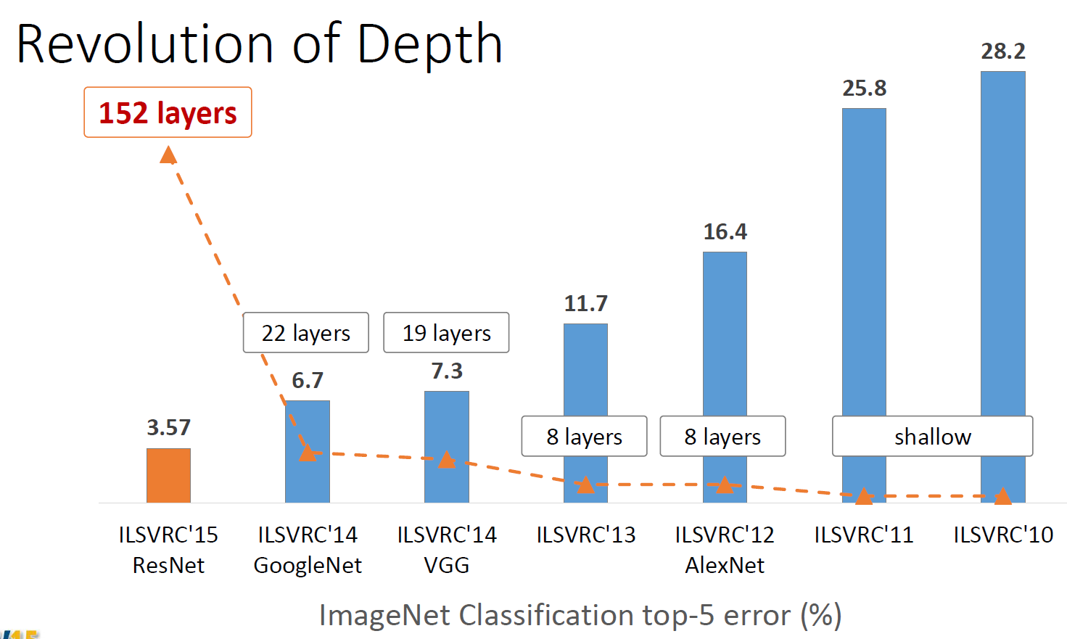
Deep Neural Network
Escape from few layers
ReLU for solving gradient vanishing problem.
Dropout…

Slide 4
Deep Neural Network
Escape from 10 layers
Normalized initialization.
Intermediate normalization layers.

Slide 5
Deep Neural Network
Escape from 50 layers
Residual network

Slide 6
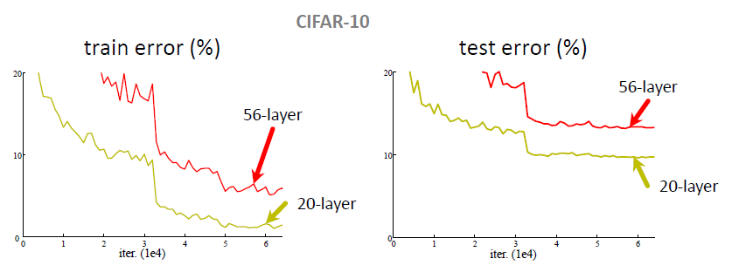
Plain Network
Plain nets: stacking 3x3 conv layers
56-layer net has higher training error and test error than 20-layers net

Slide 7
Plain Network
“Overly deep” plain nets have higher training error
A general phenomenon, observed in many datasets

Slide 8
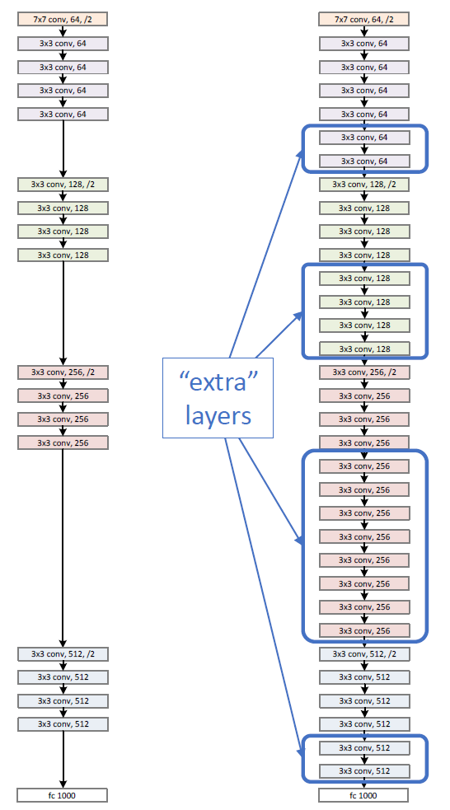
Residual Network
Naïve solution
If extra layers are an identity mapping, then a training errors does not increase

Slide 9
Residual Network
Deeper networks also maintain the tendency of results
An amount of changes is fixed
Adding layers makes smaller differences
Optimal mappings are closer to an identity

Slide 10
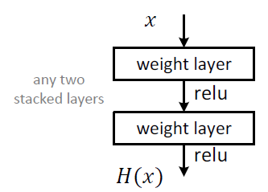
Residual Network
Plain block
Difficult to make identity mapping because of multiple non-linear layers

Slide 11
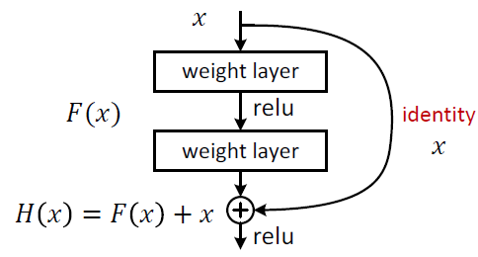
Residual Network
Residual block
If identity were optimal, easy to set weights as 0
If optimal mapping is closer to identity, easier to find small fluctuations
-> Appropriate for treating perturbation as keeping a base information

Slide 12

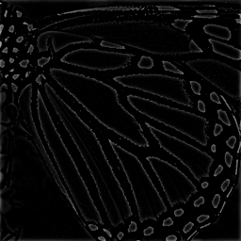

Residual Network
Difference between an original image and a changed image
Preserving base information
Some Network
residual
can treat perturbation

Slide 13
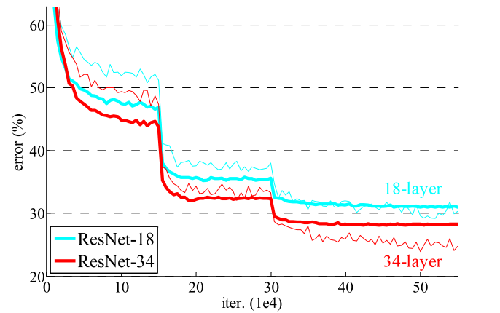
Residual Network
Deeper ResNets have lower training error

Slide 14
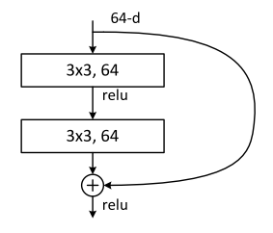
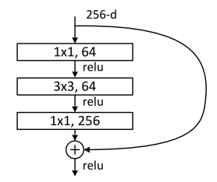
Residual Network
Residual block
Very simple
Parameter-free
A naïve residual block
“bottleneck” residual block
(for ResNet-50/101/152)

Slide 15


Residual Network
Shortcuts connections
Identity shortcuts
Projection shortcuts

Slide 16
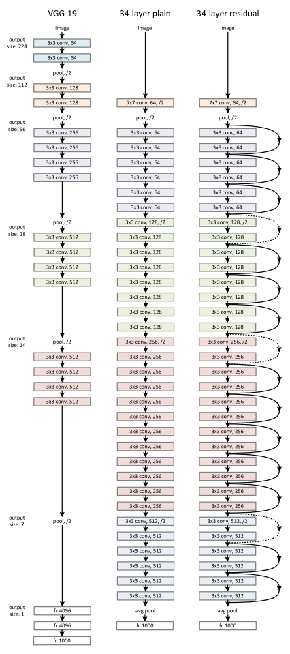
Network Design
Basic design (VGG-style)
All 3x3 conv (almost)
Batch normalization
Simple design, just deep
Other remarks
No max pooling (almost)
No hidden fc
No dropout

Slide 17
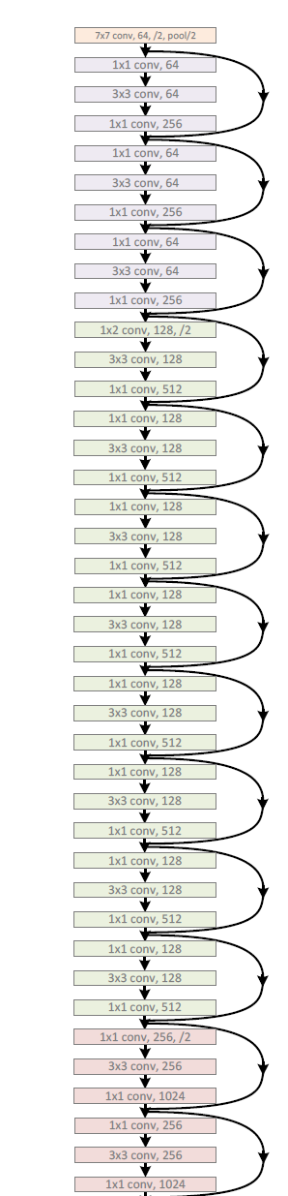
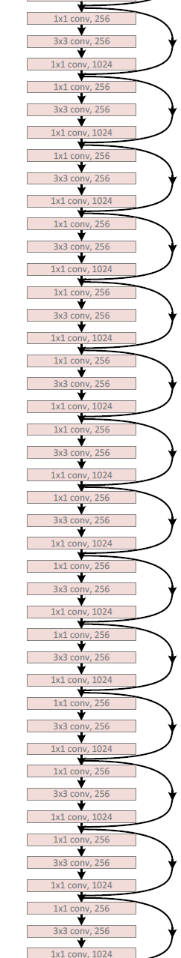
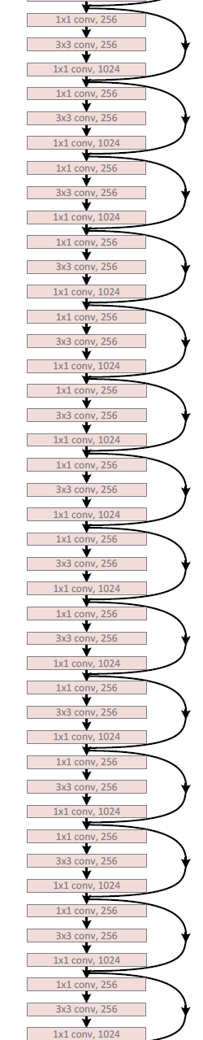
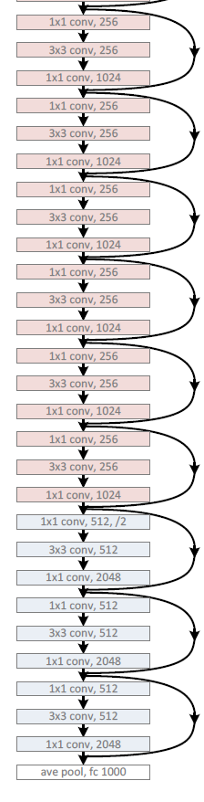
Network Design
ResNet-152
Use bottlenecks
ResNet-152(11.3 billion FLOPs) has lower complexity than VGG-16/19 nets (15.3/19.6 billion FLOPs)

Slide 18
Results
Deep Resnets can be trained without difficulties
Deeper ResNets have lower training error, and also lower test error

Slide 19
Results
Deep Resnets can be trained without difficulties
Deeper ResNets have lower training error, and also lower test error

Slide 20
Results
1st places in all five main tracks in “ILSVRC & COCO 2015 Competitions”
ImageNet Classification
ImageNet Detection
ImageNet Localization
COCO Detection
COCO Segmentation

Slide 21
Quantitative Results
ImageNet Classification

Slide 22
Result
Performances increase absolutely
Based on ResNet-101
Existing techniques can use residual networks or features from it

Slide 23
Qualitative Result
Object detection
Faster R-CNN + ResNet

Slide 24
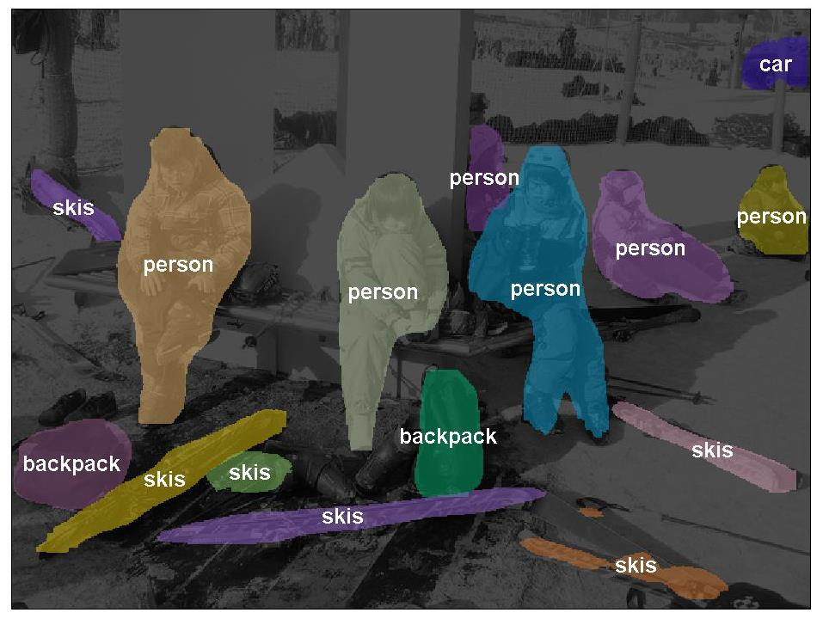
Qualitative Results
Instance Segmentation

Slide 25
Exploring over 1000 layers
Test 1202 layers
Training is finished.
Training error is similar.
Testing error is high because of over fitting.

Slide 26
Conclusion
Deeper networks are better expectably.
ResNet is very simple.
We should use it from now on.

Slide 27
Reference
Kaiming He, Xiangyu Zhang, Shaoqing Ren, & Jian Sun. “Deep Residual Learning for Image Recognition”. arXiv 2015.
Slides of Deep Residual Learning @ ILSVRC & COCO 2015 competitions.

Slide 28
Thanks! Q&A

